Slide 1
CS492 - Operating Systems OS Concepts and Structure
Georgios Portokalidis & Jun Xu
Reading: Zybook Ch 1.3, MOS Ch 1.5-1.7
Slides credit: Antonio Barbalace, Herbert Bos, Cristiano Giuffrida

Slide 2
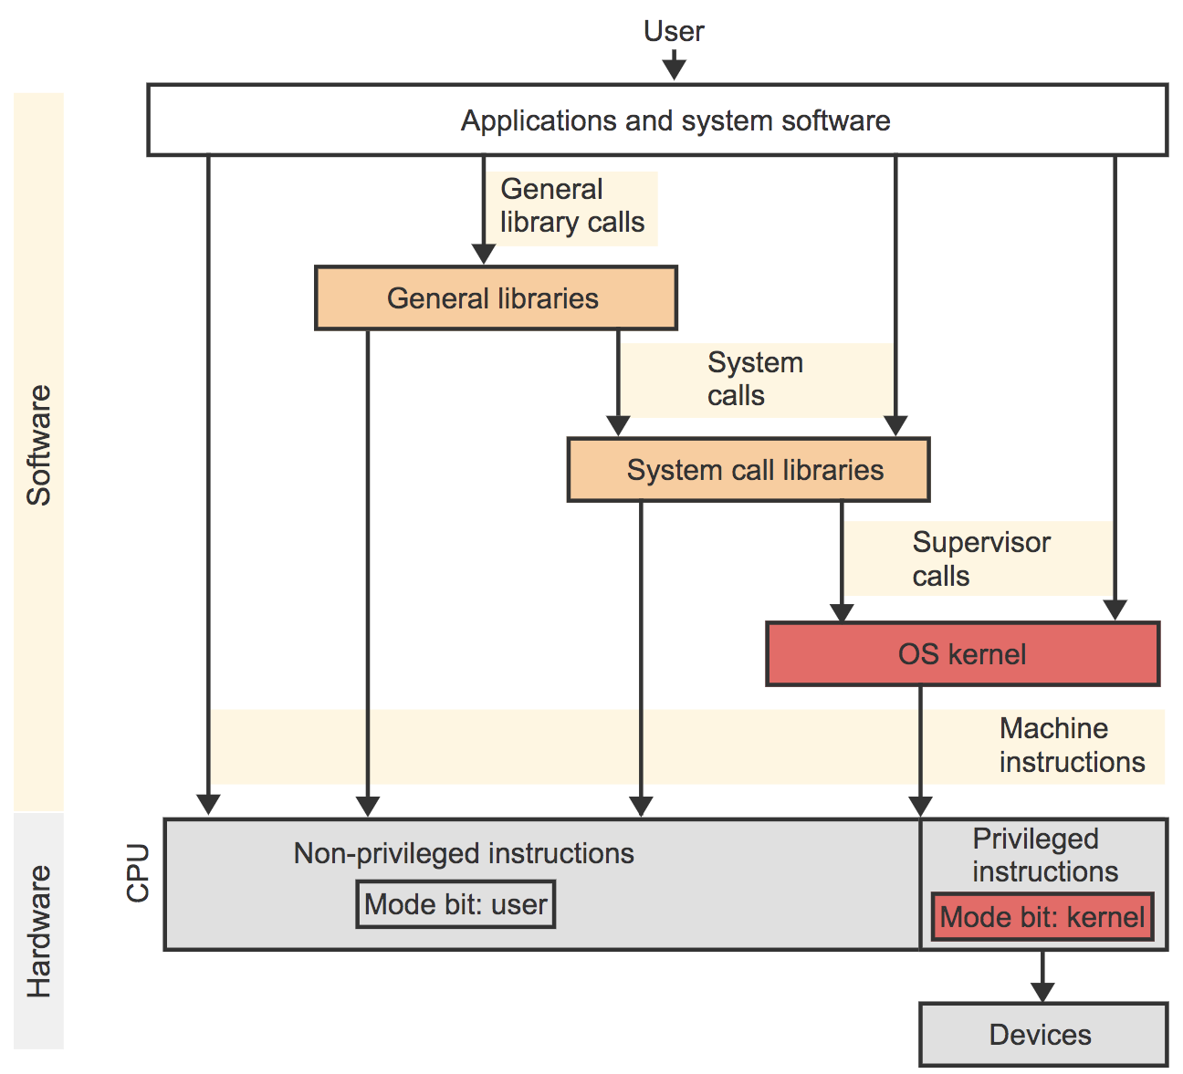
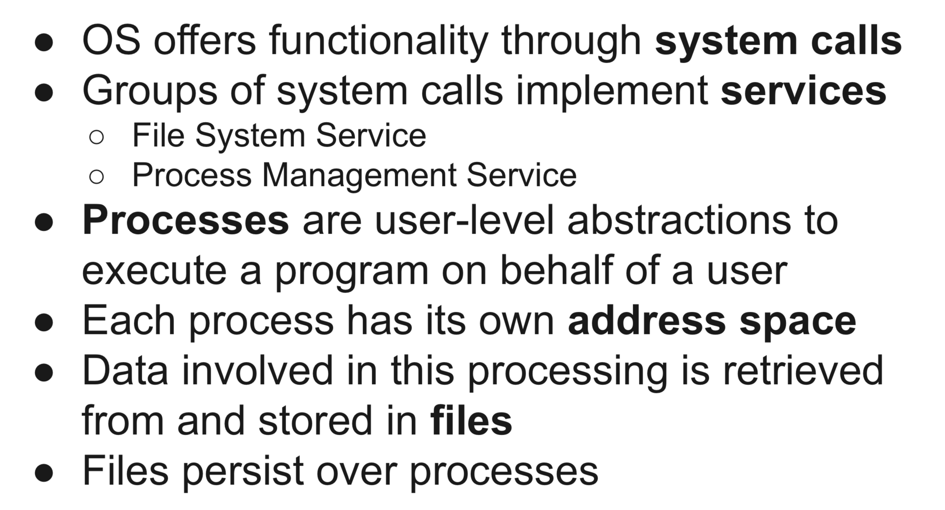
OS Concepts
Zybook Ch 1.3

Slide 3
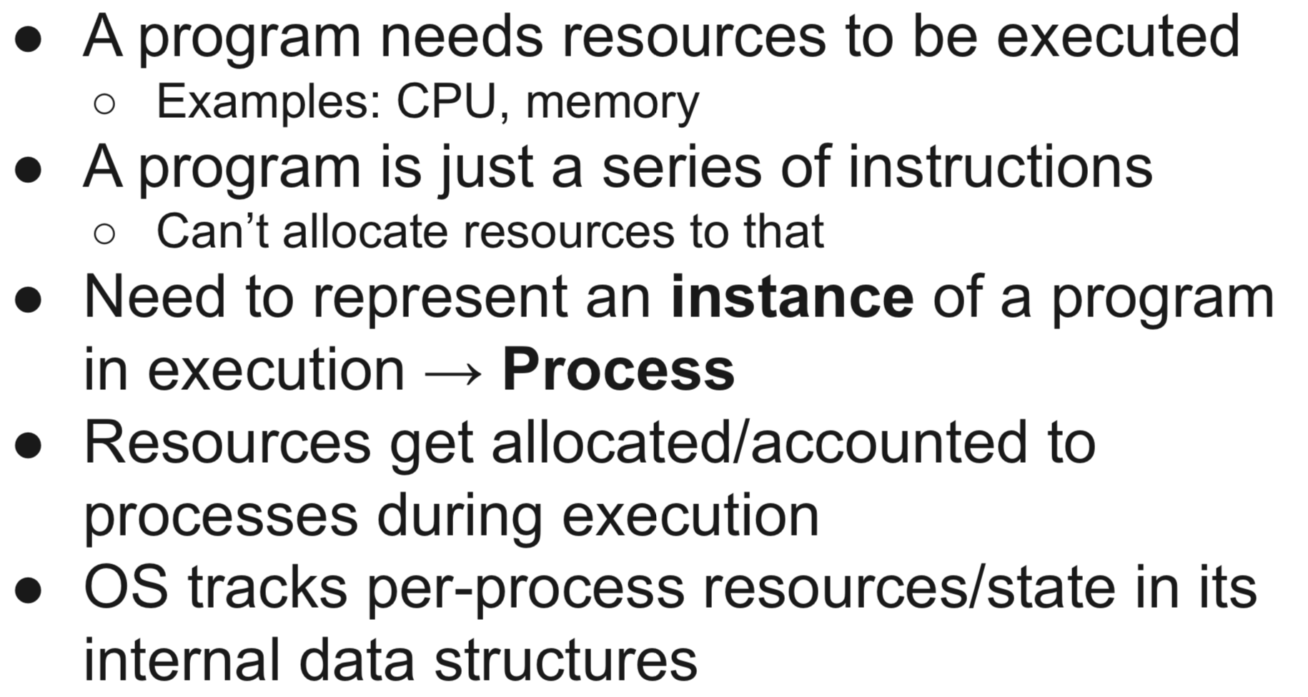
Processes
Notes:
Discuss the main syscalls (API of the OS)

Slide 4
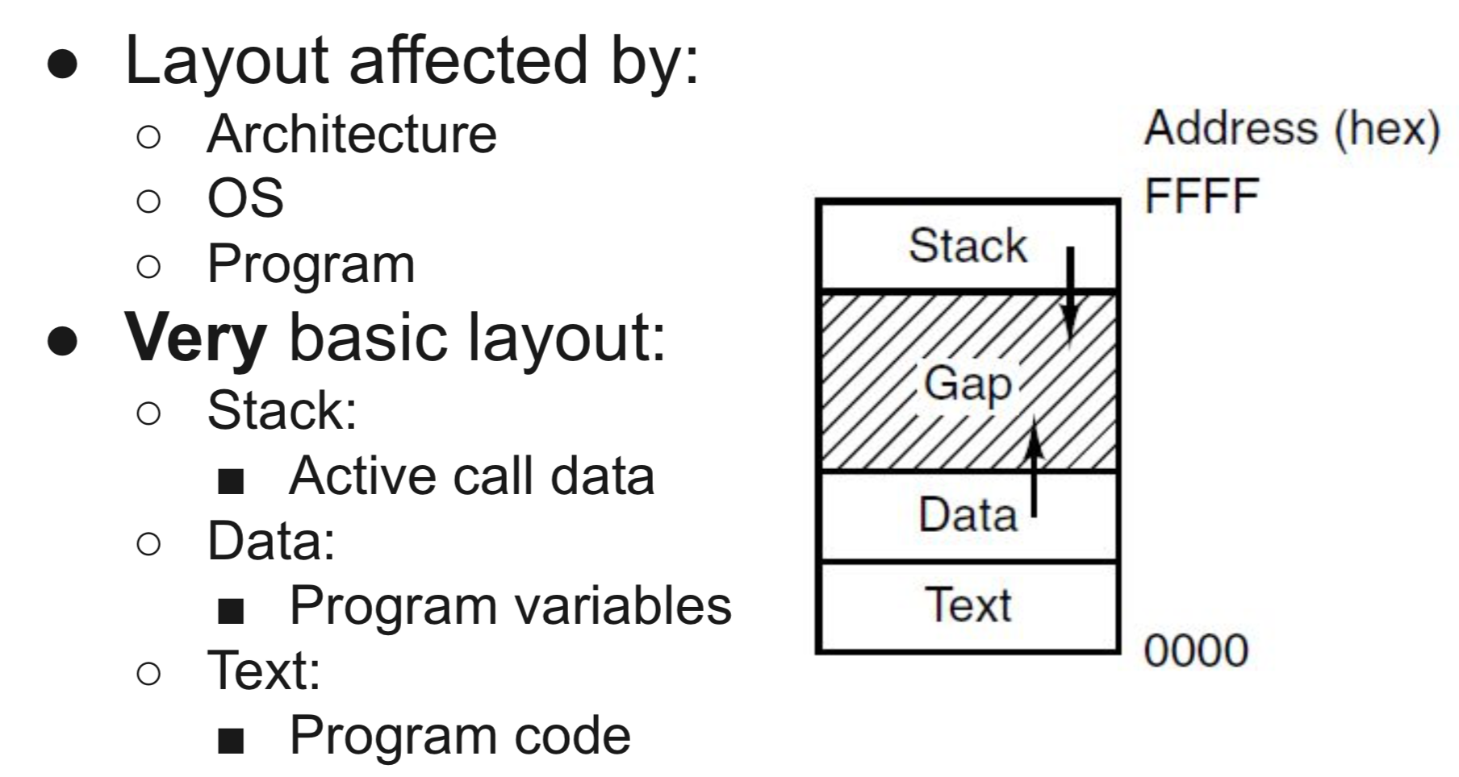
Address Spaces
Range of valid addresses in memory
A list of memory locations that can be
read and/or
written and/or
executed
Notes:
Physical address space
Virtual address space
Discuss the main syscalls (API of the OS)

Slide 5
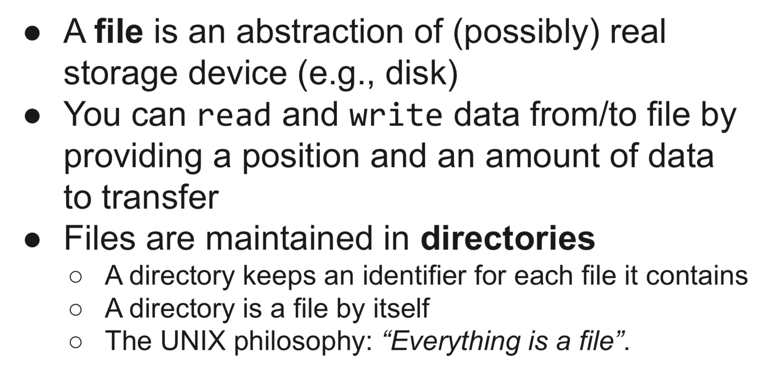
Files
Notes:
Discuss the main syscalls (API of the OS)

Slide 6
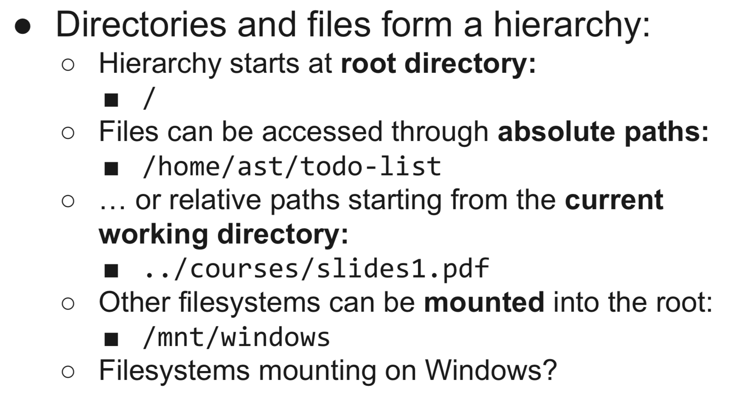
File Hierarchy

Slide 7
Special Files
“Everything is a file”:
Hardware devices are abstracted as files:
Block special files, e.g., disk:
brw-rw---- 1 root root 8, 2 Dec 4 18:04 /dev/sda2
Character special files, e.g., serial port:
crw-rw---- 1 root root 4,64 Dec 4 18:04 /dev/ttyS0
Other special files:
symbolic links
named/anonymous FIFOs (sockets/pipes)
“Everything is a file descriptor”

Slide 8
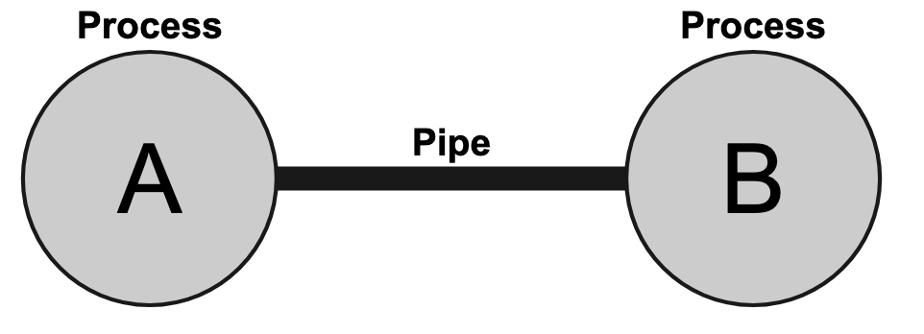
Pipes
Pseudo files allowing for multiple processes to communicate over a FIFO channel
Has to be set up in advance
Looks like a “normal” file to read and write from/to running processes

Slide 9
Input/Output
Keyboard, monitor, printer, …
OS manages these devices
IO Subsystem
Device Drivers

Slide 10
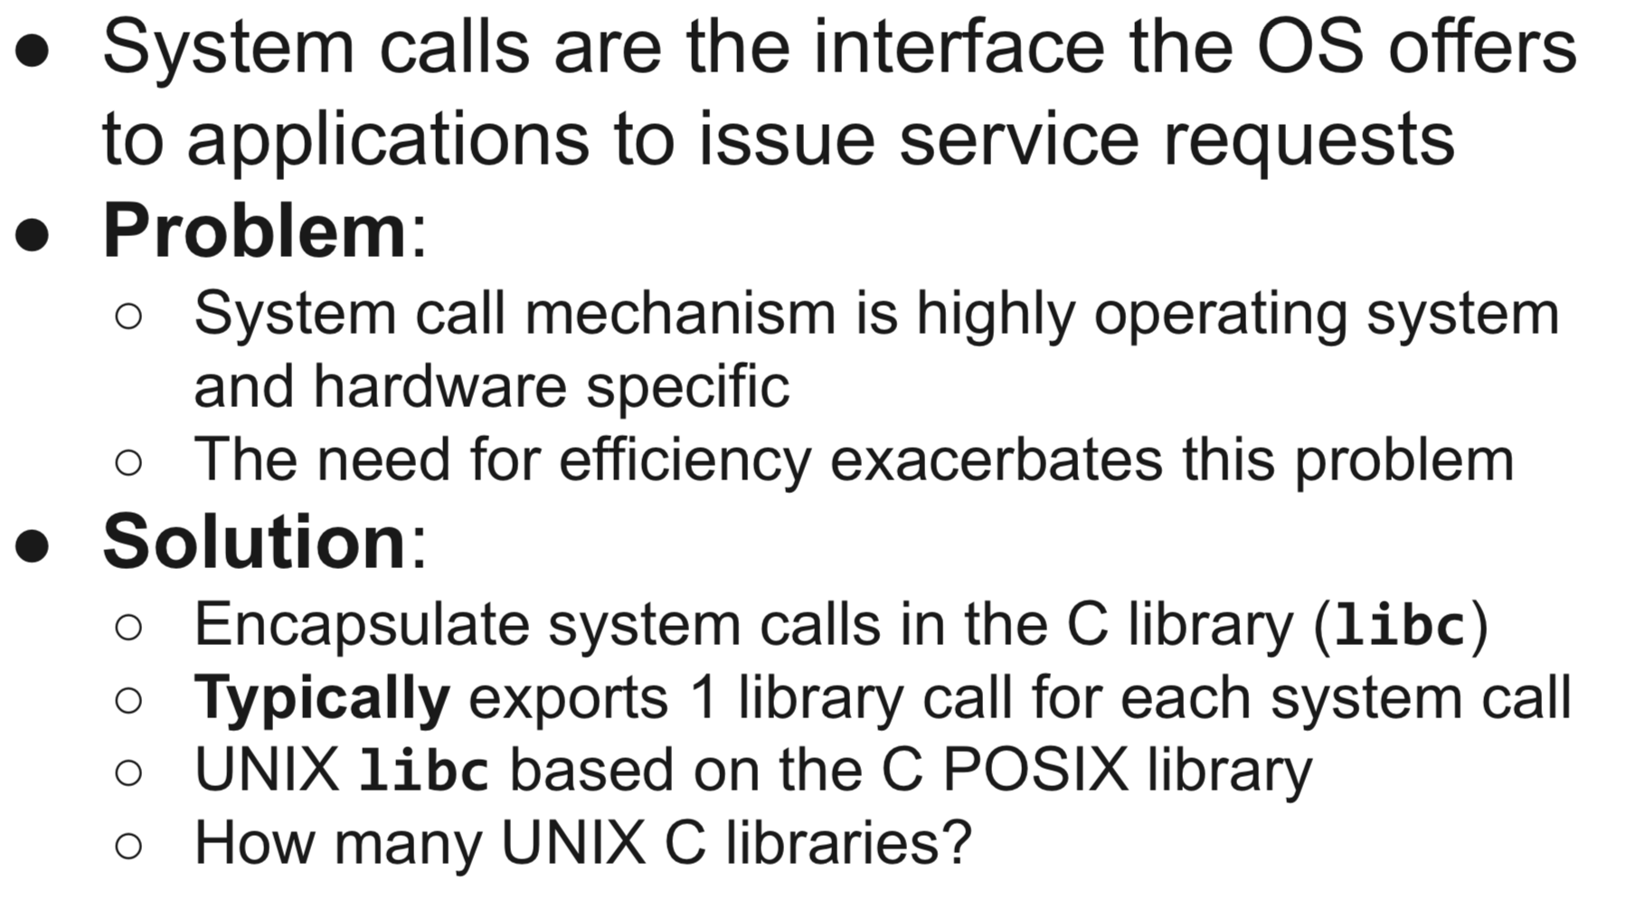
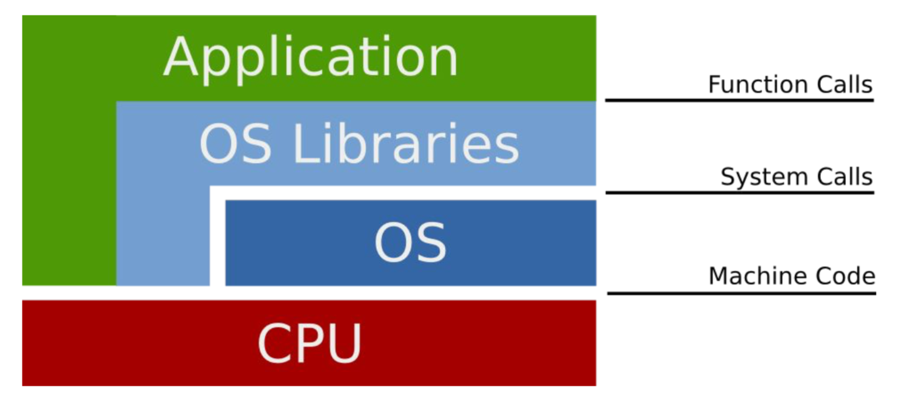
System Calls

Slide 11
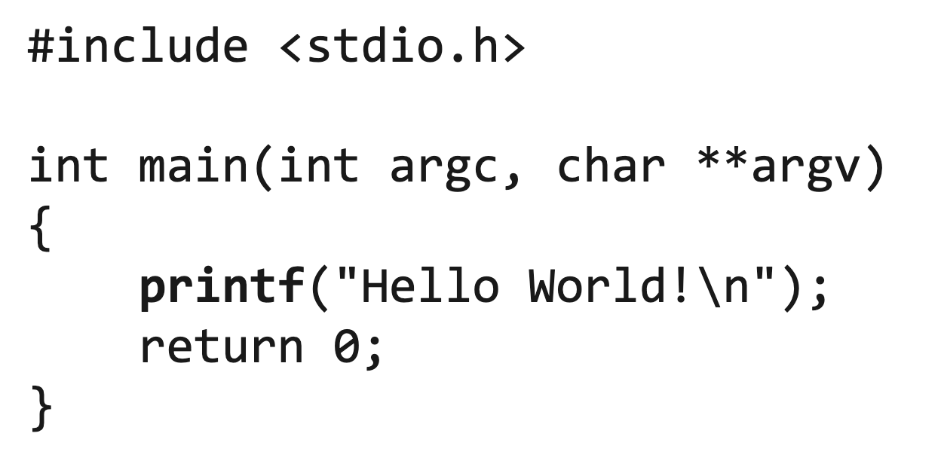
“Hello World”

Slide 12
“Hello World”
How exactly is “Hello World” printed on the console?
printf(char *str, ...);
int write(int fd, char *buf, size_t len);

Slide 13
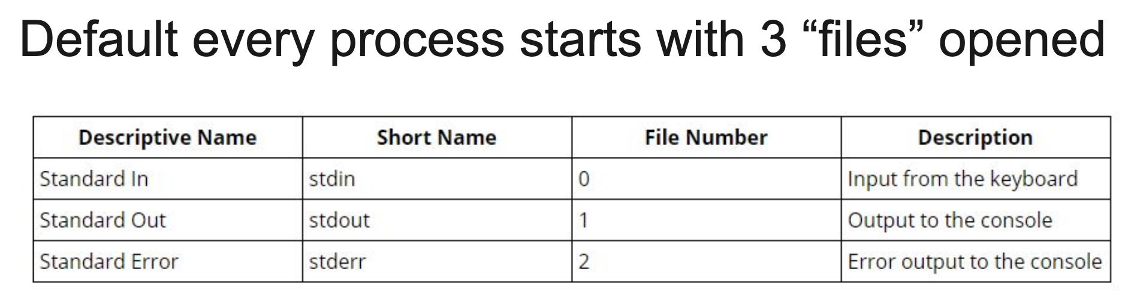
Recall: Everything is a File

Slide 14
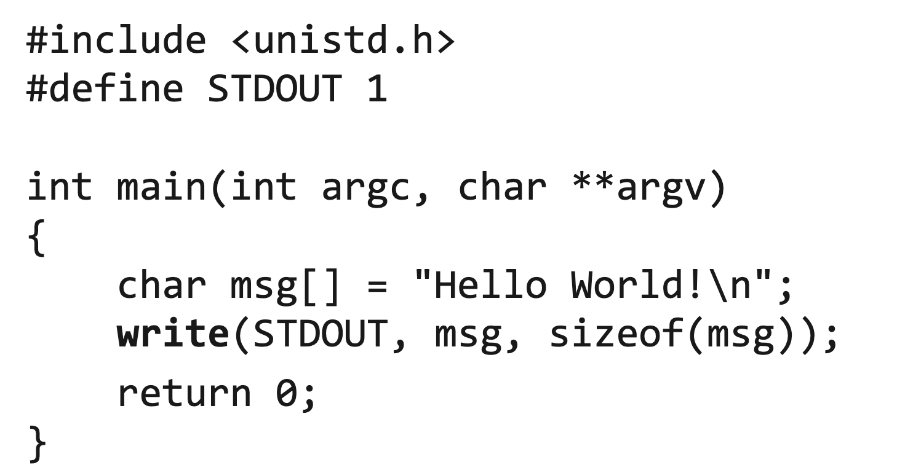
“Hello World”

Slide 15
“Hello World”
How exactly is “Hello World” printed on the console?
printf(char *str, ...);
int write(int fd, char *buf, size_t len);
int syscall(int number, …);

Slide 16
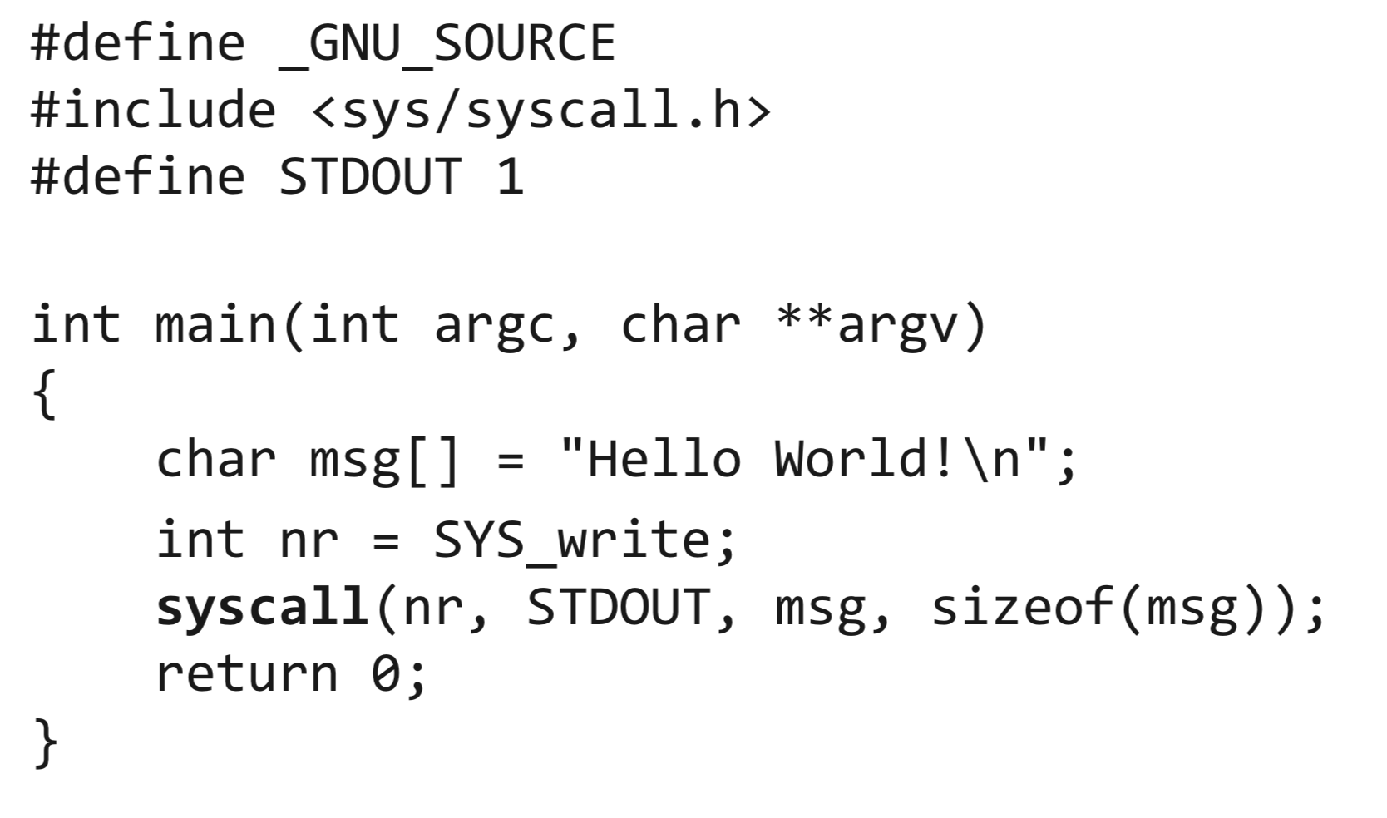
“Hello World”

Slide 17
Operating Systems Structure
What an OS looks like from the inside
Monolithic
Microkernel
…
Hybrids

Slide 18
Monolithic OS
Entire OS runs as a single program in kernel mode
Collection of procedures linked together into a single large executable binary
Every function can call the other
Very performant
Crash affects everything
Hard to understand
Processes
User
mode
Shell
Make
Other
User progs.
…
FS
Proc.
Reinc.
…
Other
Servers/Services
Kernel
mode
Disk
TTY
Netw
Print
…
Other
Drivers
Kernel, low level handles interrupts, processes, scheduling
Clock
Sys

Slide 19
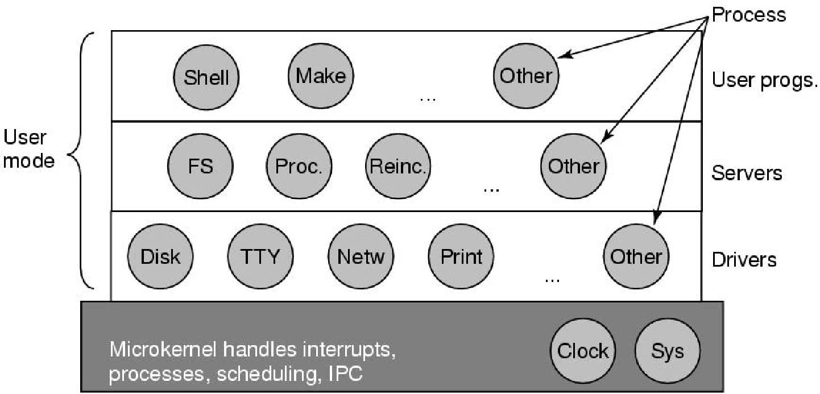
Microkernels OS
Split the OS up into small, well-defined modules
only one of which runs in kernel mode (microkernel)
the rest run as relatively powerless ordinary user processes (a bug cannot crash the entire system)
Kernel
mode
Notes:
In particular, by running each device driver and file
system as a separate user process, a bug in one of these can crash that component,
but cannot crash the entire system
Put as little as possible in the kernel (kernel mode)
Bugs in the kernel can bring down the system

Slide 20
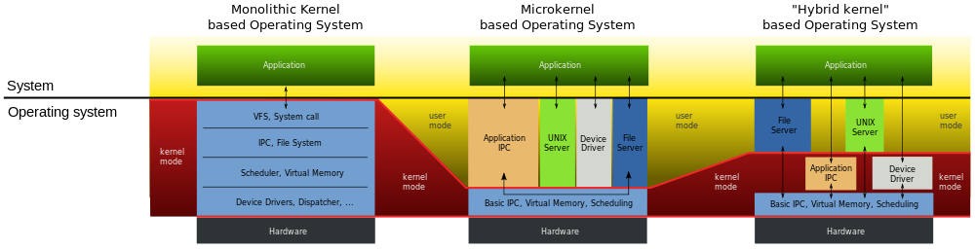
Hybrid of Monolithic and Microkernel

Slide 21
What OS has what internals?
Monolithic
UNIX
Linux
Most BSD variants
…
Microkernel
MINIX
Mac
L4 family of kernels
…
Hybrids
Windows
Xnu/Darwin
DragonFly BSD
…

Slide 22
What else? (1)
Are not OSes
They interface with the hardware (below)
They provide an hardware interface (above)
Run OSes
Linux, Windows, BSD, etc.
Unikernels (“libOS”, cf. exokernel)
Virtual machines/hypervisors (e.g., VirtualBox, Xen)
Application
Application
Unikernel
Operating System
Operating System
Hypervisor
Hardware

Slide 23
What else? (2)
Kernel-bypass solutions (e.g., DPDK, SPDK)
Are not OSes
Interface with the OS and the hardware
Run part of OSes
Mostly BSD
Application
Application
Kernel bypass
Operating
System
Hardware
Notes:
Data Plane Development Kit and Storage Performance Development Kit
DPDK:The Data Plane Development Kit is an Open source software project managed by the Linux Foundation. It provides a set of data plane libraries and network interface controller polling-mode drivers for offloading TCP packet processing from the operating system kernel to processes running in user space

Slide 24
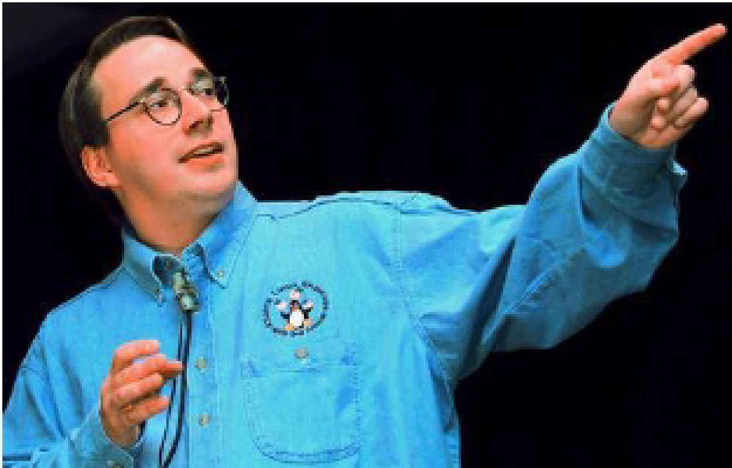
And A Few Comments…
Microsoft isn't evil, they just make really crappy operating systems.
When you say, ‘I wrote a program that crashed Windows,’ people just stare at you blankly and say, ‘Hey, I got those with the system, for free!’
Linus Torvalds

Slide 25
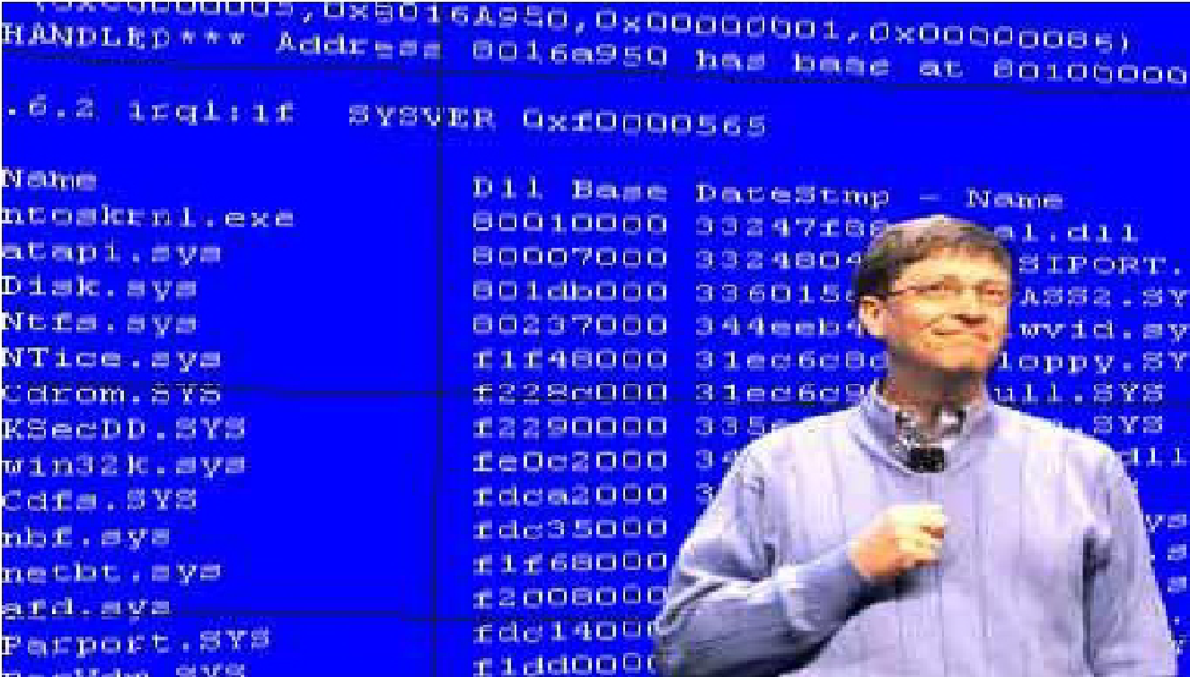
And a Few Photos
The Windows system crashed when Bill Gates gave a demo…

Slide 26
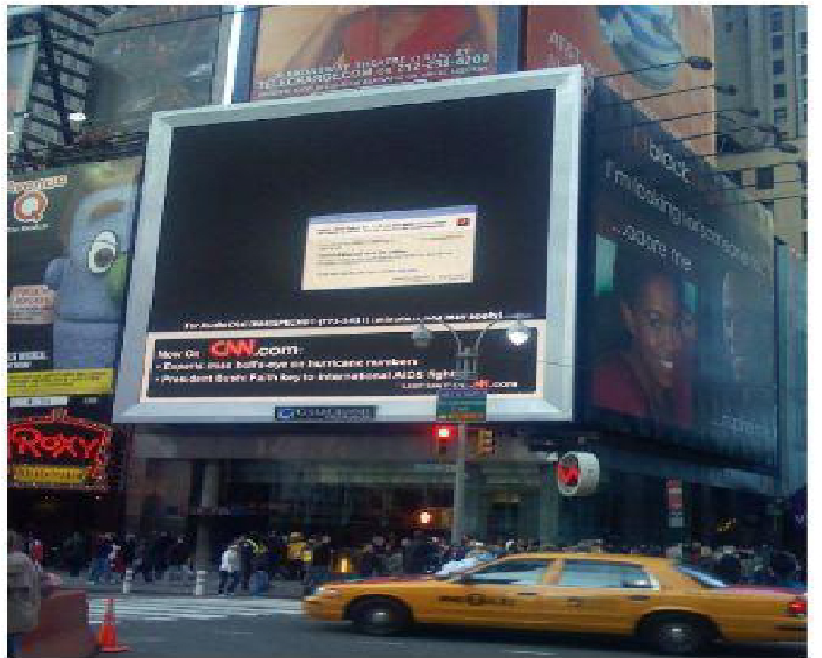
And a Few Photos (Cont.)
If you crash, crash big!

Slide 27
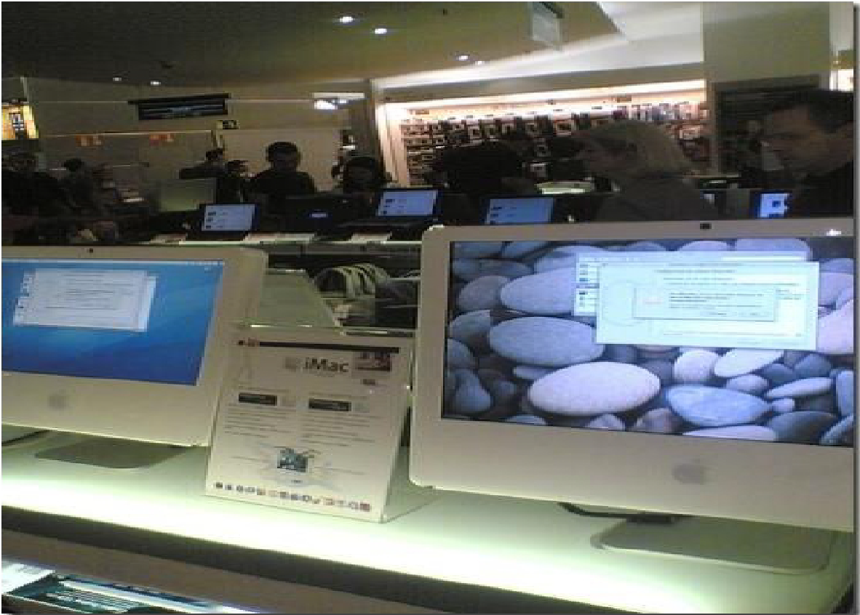
And a Few Photos (Cont.)
Crash does not happen only to Windows!

Slide 28
TODOs Next Week
Monday
No Zybooks readings and activities
Install a VM hypervisor (Virtualbox suggested if you prefer not to pay)
Wednesday
Zybooks Ch 2.1 and 2.2
Zybooks assignment: 3-Introduction-of-processes (will release after this lecture)
Friday
Zybooks Ch 2.1 and 2.2
Zybooks assignment: 4-process-management (will release after this lecture)

